Slide 1


Slide 2



WATCH THE VIDEO
WATCH THE VIDEO ON ‘HAVING A GOAL THAT DRIVES YOU’
VIMEO CHANNEL CAN ALSO BE FOUND HERE
https://vimeo.com/showcase/7013773
Enter your PASSWORD = netsixth11

Slide 3



Slide 4


Slide 5
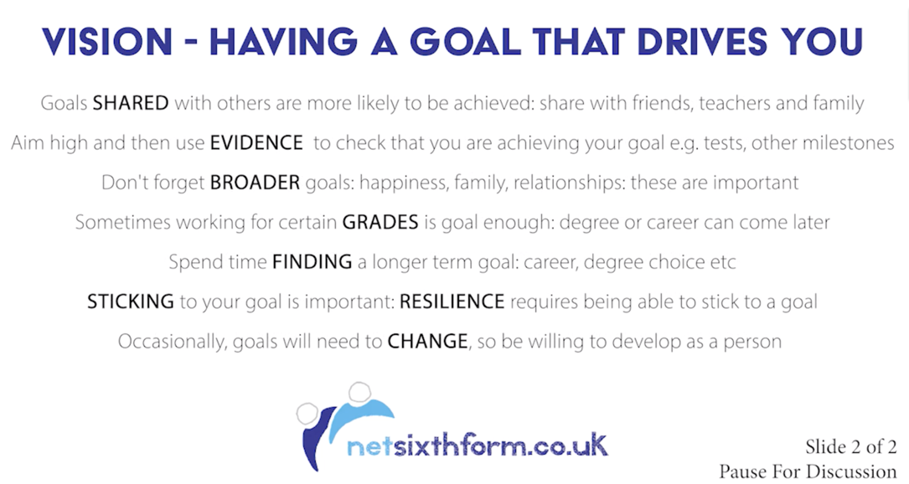

Slide 6
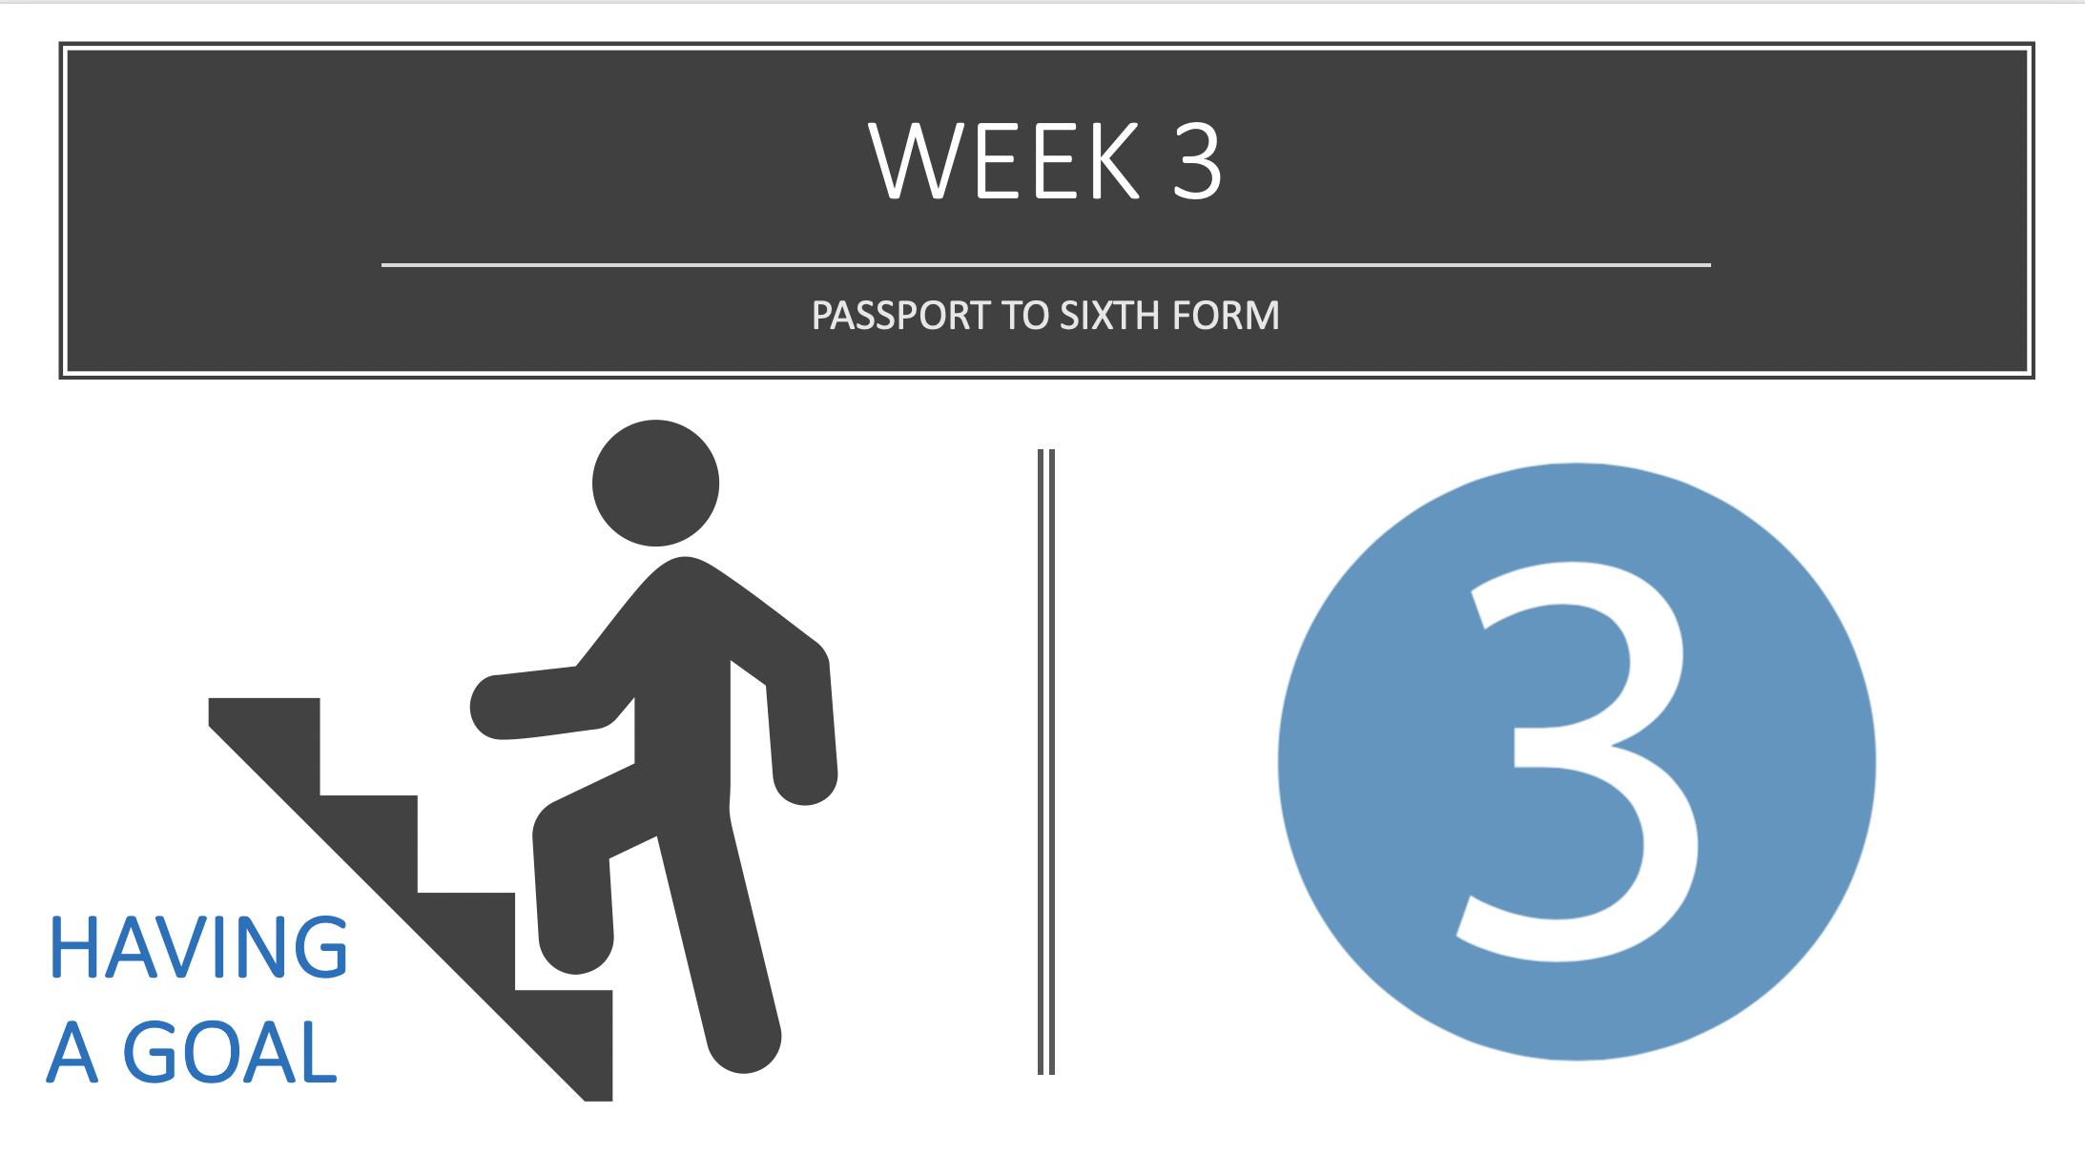

Slide 7


Slide 8



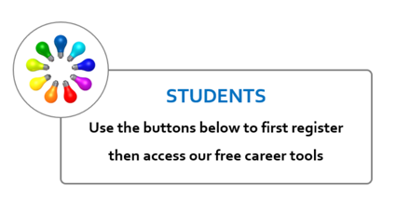
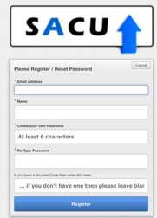
Do your research… helpful CAREER sites
https://youtu.be/TMQG4ZmDU5Y
https://sacu-student.com/?page_id=2760
https://www.prospects.ac.uk/

Slide 9

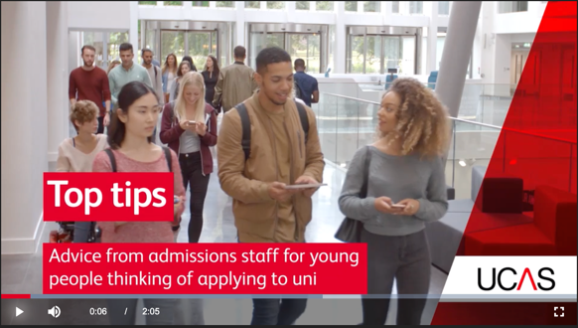


Do your research… helpful university sites
https://www.ucas.com/connect/videos/ucas?v=/uni-top-tips-people-thinking-applying
https://www.ucas.com/

Slide 10
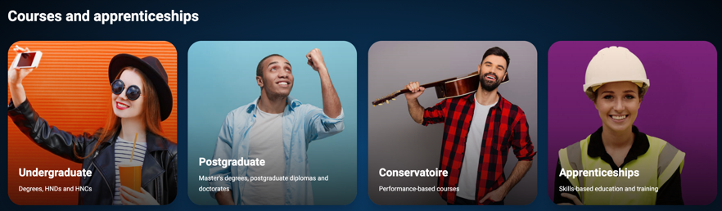

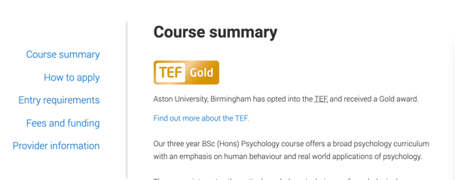
Search the GCSE grades and post 16 qualifications e.g. A-Levels and BTECs required for undergraduate degrees that interest you.
https://www.ucas.com/

Slide 11

Do your research… helpful APPRENTICESHIPS
https://www.ucas.com/

Slide 12
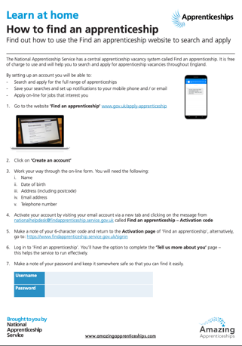




Do your research… helpful APPRENTICESHIPS other useful sites
Check out a company web site about their apprenticeships…you might need to go to individual companies to learn about apprenticeships…a bit like applying for a job. This one is PwC

Slide 13

Your goal
Having researched a possible goal, write down the:
Your goal ……
GCSEs ……
A-Levels ……
Any skills / experiences ……
Other ……

Slide 14
PASSPORT TO SIXTH FORM
GET A FOLDER (ONE FROM A GCSE SUBJECT WILL DO)
THIS FOLDER IS TO KEEP THE WORK YOU NEED AS PART OF YOUR PASSPORT TO SIXTH FORM
WRITE DOWN YOUR GOAL(S) and WHAT YOU NEED TO ACHIEVE IT and PUT THE NOTES IN THE FOLDER READY TO SUBMIT WHEN ASKED

Slide 15


Week 4 is all about Choosing A-Levels, BTEC and other post 16 courses

